Slide 1



Slide 2



01CE0503 - Design and Analysis of Algorithm
Unit - 1
Introduction to Design and Analysis of Algorithms
Prof. Jaydeep K. Ratanpara
Computer Engineering Department

Slide 3



OUTLINE
What is an algorithm?
Mathematics for Algorithmic Sets
Functions and Relations
Vectors and Matrices
Linear Inequalities and Linear Equations

Slide 4
WHAT IS AN ALGORITHM?
Informally, an algorithm is any well-defined computational procedure takes some value, or set of values, as input produces some value, or set of values, as output.
“The algorithm is defined as a collection of unambiguous instructions occurring in some specific sequence and produce output for given set of input in finite time.”

Slide 5
WHAT IS AN ALGORITHM?
EXAMPLE : COFFEE ALGORITHM
Input: Ingredients
Output: A cup of coffee
Steps:
Pour drinking water into electric kettle
Plug electric kettle and wait for it to boil
While waiting, prepare coffee cup
Add instant coffee powder into cup
Check boiling water
If water is boiled, unplug kettle and pour water into cup
If water is not boiled, press the “on” switch to continue and wait until boiled
Refer back to step 6
Stir coffee mix
Drink!

Slide 6
WHAT IS AN ALGORITHM?
ALGORITHM : DESIGN AND ANALYSIS
Algorithmic is a branch of computer science that consists of designing and analyzing computer algorithms
The “design” pertain to
The description of algorithm at an abstract level by means of a pseudo language
Proof of correctness that is, the algorithm solves the given problem in all cases.
The “analysis” deals with performance evaluation (complexity analysis).

Slide 7
Characteristics of Algorithm
Unambiguous : Algorithm should be clear and unambiguous. Each of its step (or phases), and their input/outputs should be clear and must lead to only one meaning.
Input : An algorithm should have 0 or more well defined inputs.
Output : An algorithm should have 1 or more well defined outputs, and should match the desired output.
Finiteness : Algorithms must terminate after a finite number of steps.
Feasibility : Should be feasible with the available resources.
Independent : An algorithm should have step-by-step directions which should be independent of any programming code.

Slide 8
MATHEMATICS FOR ALGORITHMIC SETS
Set: A set is a collection of different things (distinguishable objects or distinct objects) represented as a unit.
The objects in a set are called its elements or members.
Set is represent by Capital Letter and { , }, curly braces. Every element is separated by comma.
If an object x is a member of a set S, we write x ∈ S.
On other hand, if x is not a member of S, we write x ∉ S.
Set of vovles- {a, e, i, o, u}

Slide 9
MATHEMATICS FOR ALGORITHMIC SETS
A set cannot contain the same object more than once
i.e. consider the set S= {7, 21, 57} then
7 ∈ {7, 21, 57} and 8 ∉ {7, 21, 57} or
7 ∈ S and 8 ∉ S.
We can also describe a set containing elements according to some rule.
We write {n : rule about n}
Thus, {n : n = m² for some m ∈ N } means that a set of perfect squares.

Slide 10
MATHEMATICS FOR ALGORITHMIC SETS
EMPTY SET: A Set contain no member, denoted as ∅ (null) or { }.
INFINITE SET: A set contains infinite elements. For example, set of integers, set of negative integers, etc.
SUB SET:
For two sets A and B, we say that A is a subset of B, written A⊆ B, if every member of A also is a member of B.
Formally, A ⊆ B if x ∈ A implies x ∈ B Written x ∈ A => x ∈ B.
A= {1,2,3}, B={1,2,3,4,5} then A ⊆ B

Slide 11
MATHEMATICS FOR ALGORITHMIC SETS
PROPER SUBSET:
Set A is a proper subset of B, written A ⊂ B, if A is a subset of B and not equal to B.
That is, a set A is proper subset of B if A ⊆ B but A ≠ B.
EQUAL SETS:
The sets A and B are equal, written A = B, if each is a subset of the other.
let A and B be sets. A = B if A ⊆ B and B ⊆ A.
A= {1,2,3}, B={1,2,3} then A = B
POWER SET:
Let A be the set.
The power of A, written P(A) or 2A, is the set of all subsets of A.
That is, P(A) = {B : B ⊆A}.
For example, consider A={x, y, z}.
The power set of A is {{}, {x}, {y}, {z}, {x, y}, {y, z}, {x, z}, {x, y, z}}.

Slide 12
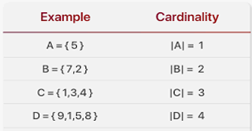
MATHEMATICS FOR ALGORITHMIC SETS
SET CARDINALITY: The number of elements in a set is called cardinality or size of the set, denoted |S| or sometimes n(S).
Two sets have same cardinality if their elements can be put into a one-to-one correspondence.
Different cardinality set can be one to many, many to one and many to many.
It is easy to see that the cardinality of an empty set is zero i.e., |∅| .

Slide 13
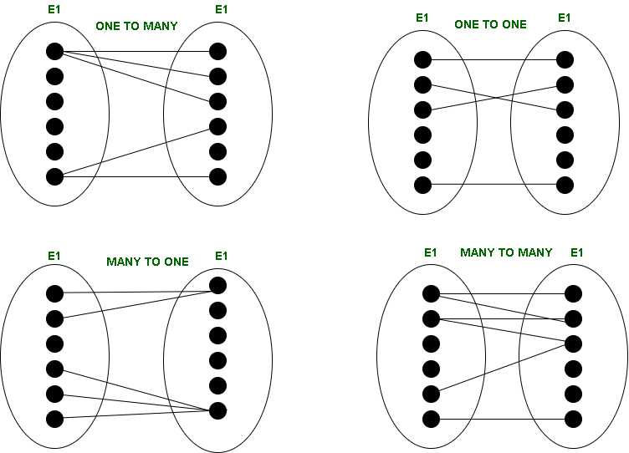
MATHEMATICS FOR ALGORITHMIC SETS

Slide 14
MATHEMATICS FOR ALGORITHMIC SETS
ONE-TO-ONE (1:1) – When one entity in each entity set takes part at most once in the relationship, the cardinality is one-to-one.
ONE-TO-MANY (1: N) – If entities in the first entity set take part in the relationship set at most once and entities in the second entity set take part many times (at least twice), the cardinality is said to be one-to-many.
MANY-TO-ONE (N:1) – If entities in the first entity set take part in the relationship set many times (at least twice), while entities in the second entity set take part at most once, the cardinality is said to be many-to-one.
MANY-TO-MANY (N: N) – The cardinality is said to be many to many if entities in both the entity sets take part many times (at least twice) in the relationship set.

Slide 15
MATHEMATICS FOR ALGORITHMIC SETS
MULTISET: It’s a collection of unordered numbers (or elements), where every element x occurs a finite number of times.
The difference between sets and multisets is in how they address multiples:
a set includes any number at most once,
while a multiset allows for multiple instances of the same number.
There is just one set with elements a and b, the set {a,b},
but there are many multisets: {a, b, b}, {a, a, b}, and {a, a, a, a, b, b} are just a few.

Slide 16
MATHEMATICS FOR ALGORITHMIC SETS
OPERATIONS ON SET:
Union: The union of A and B, written A ∪ B, is the set we get by combining all elements in A and B into a single set.
That is, A ∪ B = { x : x ∈ A or x ∈ B}
A = {1,2,3} B= {1,2,4} then A ∪ B = {1,2,3,4}
Intersection: The intersection of set A and B, written A∩B, is the set of elements that are both in A and in B.
That is, A ∩ B = { x : x ∈ A and x ∈ B}
A = {1,2,3} B= {1,2,4} then A ∩ B = {1,2}
Difference : Let A and B be two sets. The difference of A and B is
A - B = {x : x ∈ A and x ∉ B}.
For example, let A = {1, 2, 3} and B = {2, 4, 6, 8}.
The set difference A - B = {1,3} while B - A = {4, 6, 8}.

Slide 17
MATHEMATICS FOR ALGORITHMIC SETS
EXAMPLE: Let A={1,3,5,7} and B={3,5,9,8}
Find the following
1)Power set A & B
2) Union of Sets
3) Intersection of Sets
4) Difference of Sets A-B, B-A

Slide 18
MATHEMATICS FOR ALGORITHMIC SETS
OPERATIONS ON SET
Universal Set: All set under consideration are subset of some large set U called universal set.
Complement of a Set:
Given a universal set U, the complement of A, written A’, is the set of all elements under consideration that are not in A.
Formally, let A be a subset of universal set U. The complement of A in U is
A’ = U – A
OR
A’ = {x : x ∈ U and x ∉ A}
For Example, U = {10,20,30,40} A= {10,20} A’ = U-A = {30,40}
For any set A ⊆ U, we have following
1) A’’ = A 2) A ∩ A’ = ∅ 3) A ∪ A’ = U

Slide 19
MATHEMATICS FOR ALGORITHMIC SETS
CARTESIAN PRODUCT OR CROSS PRODUCT
Let A and B are two sets,
the cross product of A and B, written A x B,
the set of all possible ordered pairs wherein the first element is a member of the set A and the second element is a member of the set B.
Formally, A x B = {(a, b) : a ∈ A, b ∈ B}
let A = {1, 2} and B = {x, y, z} then
A x B = {(1, x), (1, y), (1, z), (2, x), (2, y), (2, z)}
Let |A| and |B| be the number of elements in set A and set B respectively.
Let the number of elements in Cartesian product of the two sets be |X|.
Then, |X| = |A| x |B|

Slide 20

FUNCTIONS AND RELATIONS
A function in very abstract terms can be thought of as something that will take an input and produce an output.
For example, Weatherman takes a reading from the thermometer.
The thermometer usually gives a reading in Celsius or Fahrenheit.
The weatherman then converts it using some formula.
That formula can be thought of as something which resides in the “Function” box given in the figure above.
It takes input temperature in degree Celsius and converts it into Fahrenheit.
Now, can one reading of degree Celsius give us two different temperature outputs in Fahrenheit? No.
That’s why a rule is put on the function that it cannot give two outputs on taking one input.

Slide 21
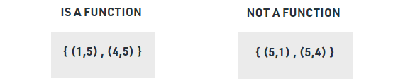
FUNCTIONS AND RELATIONS
Functions: A function is a set of arranged pairs where each input component has just ONE output component related with it.
It can be defined as the relationship between two sets.
Using functions we can map one element of one set to some other element of another set.
Note: A function may have two input values assigned to the same output value but can NOT have two output values assigned to the same input value.
Note that the square function maps both 1 and −1 to 1;
A function is denoted as f.
if f (x) = x³ then we say that f of x equals to x cube, then we can have
f(2) = 8

Slide 22
FUNCTIONS AND RELATIONS
Let us also look at the definition of Domain and Range, image and Pre-image of a function.
Domain : It is a collection of the first values in the ordered pair (Set of all input (x) values).
Range : It is a collection of the second values in the ordered pair (Set of all output (y) values).
Example: In the relation, {(-2, 3), {4, 5), (6, -5), (-2, 3)},
The domain is {-2, 4, 6} and range is {-5, 3, 5}.
Image and Pre-image :
If f is a function from set A to B and (a, b) ∈ f, then f(a) = b. b is called the image of a under f and a is called the pre-image of b under f.

Slide 23
FUNCTIONS AND RELATIONS
Relation : Let A and B be two sets. A relation R from A to B is a subset of the Cartesian product A x B.
Let A and B be two sets. Any subset P of their Cartesian product A x B is a relation.
When x ∈ A and y ∈ B, we say that x is in relation with y according to P, denoted x P y, if and only if (x, y) ∈ P.
The subset is made up by describing a relationship between the first element and the second element of elements in A x B.
Example: R = {(1,2), (2, -3), (3,5)}
Here in the above example, set of all first elements i.e {1,2,3} is called Domain while the set of all second elements i.e {2,-3,5} is called the range of the relation.

Slide 24
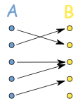
FUNCTIONS AND RELATIONS
TYPES OF FUNCTIONS In terms of relations, we can define the types of functions as:
One to one or Injective function: A function f: X → Y is said to be One to One if for each element of X there is a distinct element of Y.
Many to one function: A function which maps two or more elements of X to the same element of set Y.
X
Y
Injective

Slide 25
FUNCTIONS AND RELATIONS
Onto Function or Surjective function: A function f: X → Y is surjective if for each y ∈ Y there exists at least one x ∈ X such that f(x)=y. In other words, it is surjective if its range is the same as its image. (Other Definition: A function for which every element of set Y there is pre-image in set X).
One-one correspondence or Bijective function: A function f: X → Y is bijective if it is both injective and surjective.
X
Y
Surjective
X
Y
Bijective

Slide 26
VECTORS AND MATRICES
A vector, V, means a list (or n-tuple) of numbers:
V = (V1, V2, . . . , Vn) where Vi are called the components of V.
If all the Vi are zero, then V is called the zero vector.
Given vectors V and U are equal i.e., V = U, if they have the same number of components and if corresponding components are equal.

Slide 27
VECTORS AND MATRICES
Addition of Two Vectors
Sum of two vectors V and U, (V + U) is the vector obtained by adding corresponding components from V and U.

Slide 28
VECTORS AND MATRICES
Multiplication of a Vector by a Scalar
The product of a scalar k and a vector V i.e., kV, is the vector obtained by multiplying each component of V by k.
Here, we define -V = (-1)V and V-U = V +(-U).
It is not difficult to see k(V + U) = kV + kU where k is a scalar and V and U are vectors.

Slide 29
VECTORS AND MATRICES
Matrix
In algorithmic (study of algorithms), we like to write a matrix A as A(aij).
Column Vector
A matrix with only one column is called a column vector.
Zero Matrix
A matrix whose entries are all zero is called a zero matrix and denoted by 0.

Slide 30
VECTORS AND MATRICES
Matrix Addition

Slide 31
VECTORS AND MATRICES
Scalar Multiplication

Slide 32
VECTORS AND MATRICES
Properties of Matrix under Addition and Scalar Multiplication
Let A, B, and C be matrices of same size and let k and l be scalars.
A + B = B + A
A + 0 = 0 + A = A
A + (-A) = (-A) + A = 0
k(A + B) = kA + kB
(k + l)A = kA + lA
(kl)A = k(lA)

Slide 33
VECTORS AND MATRICES
Matrix Multiplication
A and B are two matrices such that the number of columns of A is equal to number of rows of B.
matrix A is an m×p matrix and matrix B is a p×n matrix.
The product of A and B is the m×n matrix.
ij-entry is obtained by multiplying the elements of the ith row of A by the corresponding elements of the jth column of B and then adding them.
It is important to note that if the number of columns of A is not equal to the number of rows of B, then the product AB is not defined.

Slide 34
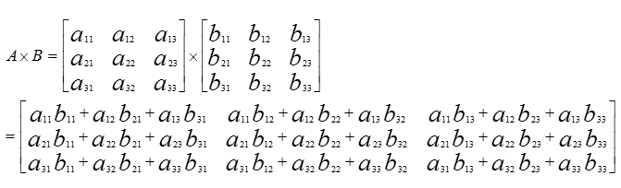
VECTORS AND MATRICES
Matrix Multiplication
A and B are two matrices such that the number of columns of A is equal to number of rows of B.

Slide 35
VECTORS AND MATRICES
Properties of Matrix Multiplication
Let A, B, and C be matrices and let k be a scalar.
(AB)C = A(BC)
A(B+C) = AB + AC
(B+C)A = BA + CA
k(AB) = (kA)B = A(kB)

Slide 36
VECTORS AND MATRICES
Transpose of Matrix
The transpose of a matrix A is obtained by writing the row of A, in order, as columns and denoted by AT.
It is not hard to see that if A is an m×n matrix, then AT is an n×m matrix.

Slide 37

VECTORS AND MATRICES
Determinant
The determinant of order one is:
The determinant of order two is:
The determinant of order three is:

Slide 38
LINEAR INEQUALITIES
The term inequality is applied to any statement involving one of the symbols
<, >, ≤, ≥
Examples of inequalities are:
x1 ≥ 1
x + y + 2z > 16
p + q ≤ ½
ax + by > 1

Slide 39
LINEAR INEQUALITIES
Fundamental Properties of Inequalities
If a ≤ b and c is any real number, then a + c ≤ b + c. For example, -3 ≤ -1 implies -3+4 ≤ -1 + 4.
If a ≤ b and c is positive, then ac ≤ bc. For example, 2 ≤ 3 implies 2(4) ≤ 3(4).
If a ≤ b and c is negative, then ac ≥ bc. For example, 3 ≤ 9 implies 3(-2) ≥ 9(-2).
If a ≤ b and b ≤ c, then a ≤ c. For example, -1/2 ≤ 2 and 2 ≤ 8/3 imply -1/2 ≤ 8/3

Slide 40
LINEAR EQUATIONS
Linear equations explain some of the relationships between what we know and what we want to know and can help us solve a wide range of problems we might encounter in our everyday lives.
One Unknown : A linear equation in one unknown can always be stated into the standard form ax = b, where x is an unknown and a and b are constants.
If a is not equal to zero, this equation has a unique solution x = b/a
Ex. 2x +8 = 20 solve for x.
2x = 20-8
2x = 12
x = 12/2
x= 6

Slide 41
LINEAR EQUATIONS
Example : 25x * 35=20x
(25 * 35)x = 20x
875x = 20x
875x - 20x =20x - 20x
855x = 20x - 20x
855x = 0x
x = 0

Slide 42
LINEAR EQUATIONS
Two Unknowns : A linear equation in two unknown, x and y, can be put into the form ax + by = c, where x and y are two unknowns and a, b, c are real numbers.
Also, we assume that a and b are non zero.
Solution of Linear Equation :
A solution of the equation consists of a pair of numbers, u = (k₁, k₂), which satisfies the equation ax + by = c.
Mathematically speaking, a solution consists of u = (k₁, k₂) such that
ak₁ + bk₂ = c.
Geometrically, any solution u = (k₁, k₂) of the linear equation ax + by = c determine a point in the Cartesian plane.
Since a and b are not zero, the solution you correspond precisely to the points on a straight line.

Slide 43
LINEAR EQUATIONS
Two Equations in Two Unknowns
A system of two linear equations in two unknowns x and y is
a₁x + b₁y = c₁
a₂x + b₂y = c₂
Where a₁, a₂, b_{1,} b₂ are not zero.
A pair of numbers which satisfies both equations is called a simultaneous solution of the given equations or a solution of the system of equations.

Slide 44
LINEAR EQUATIONS
Two Equations in Two Unknowns
5x+10y =15 ………(1)
3x+2y =5 ………(2)
Multiply equation(1) with 3 and equation(2) by -5
15x+30y = 45 ……..(1)
-15x-10y = -25 …….(2)
Add equation (2) in equation (1)
20y = 20
y = 1
Put y = 1 in equation (1)
5x+10(1) = 15
5x =15-10
x = 1

